Slide 1

ACADEMIC WRITING
WEEK 2
NORLIDA ARIFFIN

Slide 2

Product description
What?
the marketing copy that explains what a product is and why it is worth purchasing
gives information to users on how to operate, assemble or manufacture a particular product
Purpose?
to supply customers with details around the features and benefits of the product so they are compelled to buy.

Slide 3
Product review VS Product description
 | Product description | Product review
1. | It is a structured form of presenting detailed information of the product. | An informal writing by the actual users of the product.
2. | Written by the manufacturer or product manager or professional experts. | Most of the time, written by the actual users of the products
3. | Focuses on ingredients, expiry date, benefits, side effects and usage of the product. The demerits of the product are most of the time neglected. | Focuses on advantages and disadvantages of the products.
4. | Written in formal writing style. | Written in an informal or friendly way.
5. | It should be approved by the project board. | Everyone can post a product review.

Slide 4
How does a Product Description help the audience?
Provide the basis for various types of technical explanations
Visualize the product
Learn about the different parts of the product
Learn about the functions of the product
Understand how the product works

Slide 5
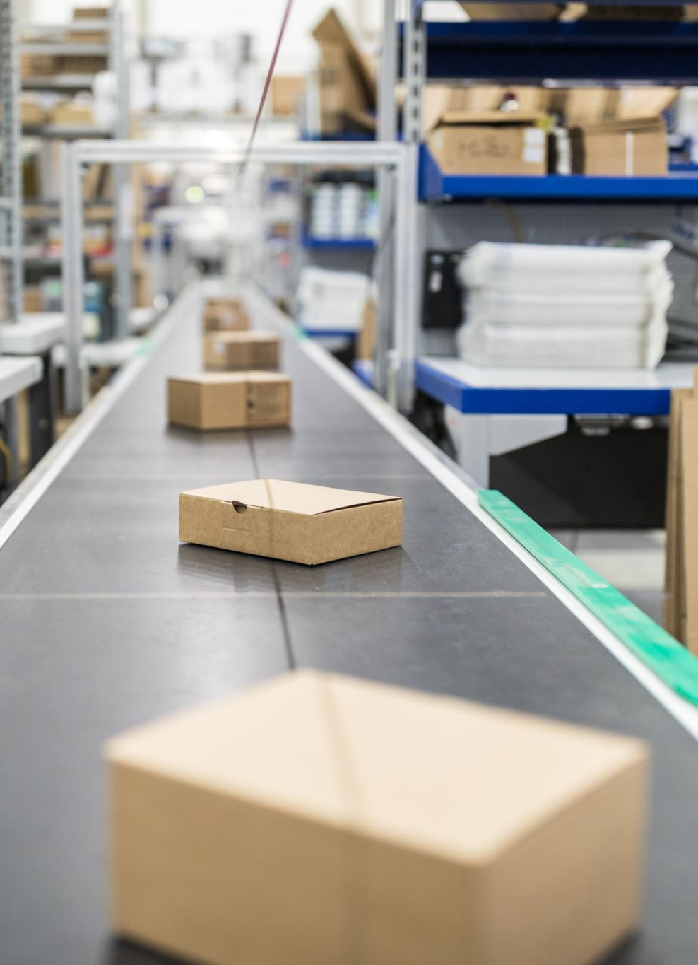
Why are product descriptions so important?
The description of any product is based on the important features, usability and many other details about it. Every seller/firm must be familiar with the major significance of adding product descriptions.

Slide 6
Benefits of product description
1.The buyers can get a proper know-how of the product before making final purchasing choice.
2.Once the interested buyers get proper information about a certain product, they can avoid purchasing the wrong product. This will result in generating more loyal customers for such products for the long-term.
3. Apart from the features and traits, readers can also care about the usability, validity and much other feasible info about the offered item.
4.In case of finding the description appealing, many interested customers end up sharing the product’s link with others (on social networking platforms).

Slide 7
What is the format and style of a Product Description?
The format of writing a product description consists of an introduction, body, and conclusion. You may want to exclude/ modify certain components of the outline to suit your objective, audience and product.
Introduction : General Description
Body : Description and Function of Parts
Conclusion and Operating Description

Slide 8
Introduce the name of the product
Explain the general use of the product
State who are the target users/ what is the target situation
Introduction
Details of product
explain important elements/ components/ specifications of the product → shape, colour, weight, dimension, price, parts
exact measurement
materials used for the product
Mechanism/operation
functions of important features
steps to use the product
Body
Conclusion
State good values of the product (flexible, durable, user-friendly, cost effective, efficient, portable)

Slide 9
Objectivity in technical description
Have you ever been in a situation where a product you purchased did not reflect its quality or function as described in the advertisement?
Sometimes this happens because the information you get has been described in a subjective way and you have been influenced by it.
Subjective descriptions do more than simply convey factual information; subjective descriptions use sensory and judgemental expressions such as “The weather was miserable”.
In contrast, objective descriptions present an impartial view, filtering out personal impressions and focusing on details any viewer could observe (“All day, we had freezing rain and gale – force winds).
A technical description should be objective.

Slide 10
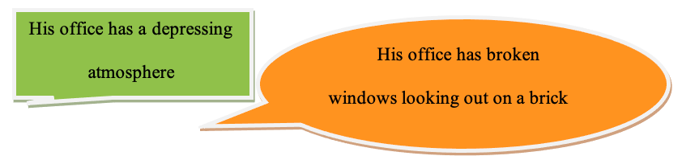
Descriptions should be objective
When writing descriptions, you should communicate the facts as they are generally known and understood.
How to remain objective?
Provide details that are visual, not emotional.
An observer vs a camera

Slide 11
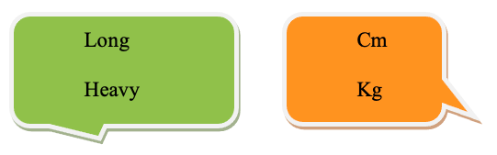
Use precise and informative language. For instance, specify locations and positions, exact measurements, weights, and dimensions
Do not confuse a precise language with overly complicated terms or needless jargons

Slide 12
What else?
An effective title promises exactly what the document will deliver.
Give readers exactly what they need.
Identify your audience and the reasons for using your description.
Focus carefully on your purpose.
Let the visual repeat, restate or reinforce the prose.
Use drawings or photographs with captions and labels.
Organize the sequence of the product description for the reader’s understanding
You can describe these relationships in spatial, functional or chronological sequence.

Slide 13
Any item or process usually has its own logical organization based on;
(1) the way it appears as a static object (spatial)
(2) the way its parts operate in order (functional)
(3) the way its parts are assembled (chronological)

Slide 14
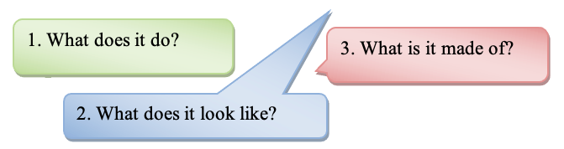
1) Spatial sequence
A spatial sequence parallels or connects the reader’s angle of vision in viewing the item.
It answers these questions:
Use this sequence when you want readers to visualize a static item or a mechanism at rest. ( a chain-saw, computer keyboard)

Slide 15
2) Functional sequence
A functional sequence shows how the different parts operate
It is best used in describing a mechanism in action ( a smoke detector, 35- millimetre camera)

Slide 16
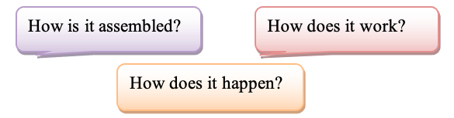
3) Chronological sequence
A chronological sequence shows the order or step-by-step stage the parts are assembled.
A chronological sequence answers these questions:
A chronological sequence is best used to visualize an item in terms of its order of assembly (such as a piece of furniture, a tent)

Slide 17
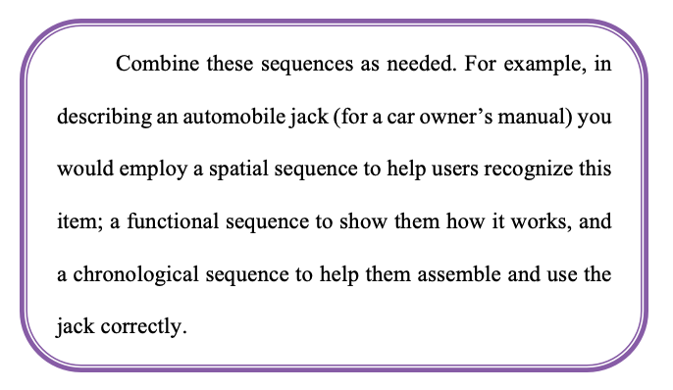
Example

Slide 18

Group activity
In your group, look for an item that you have with you and prepare a brief speech to describe that product. Give the product a new name. You can make up things in a creative way and explain the function of your product. Then, present the product to the class.
Example of a product:
An umbrella that changes colour according to the weather.

Slide 19
Based on your friends’ presentations, tick the questions in the checklist box provided below to see whether their speeches have achieved the desired objectives.
Content | (/)
Is the description objective?
Does the product name reflect the product?
Are the item’s overall features described, as well as each part?
Is each part defined before it is discussed?
Do visuals appear to provide clarification?
Will the readers be able to visualize the item’s function?
Are any details missing, unnecessary or confusing?

